Slide 1
Face and Voice Recognition
“Hello? Is it me you're looking for?”
Using Microsoft Cognitive Services
Daniel Egan - Microsoft

Slide 2
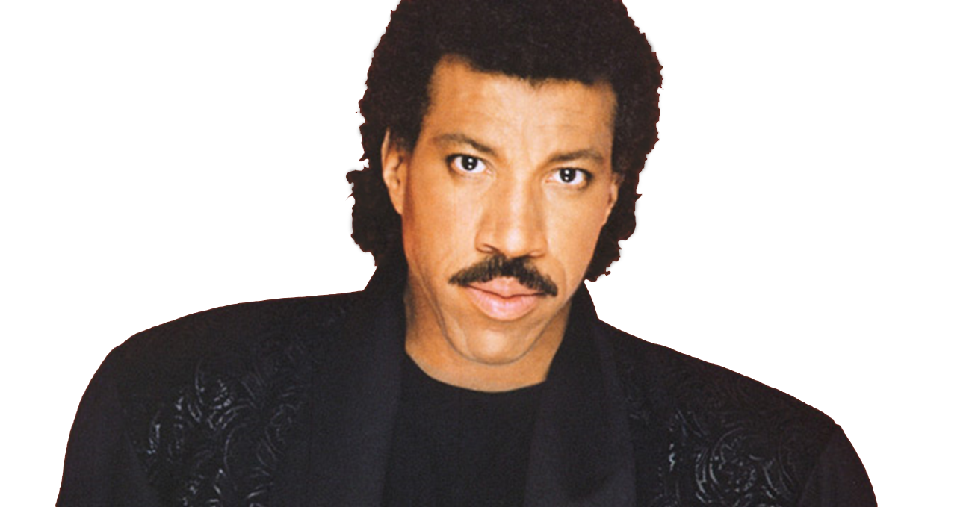

“Hello? Is it me you're looking for?”
Face and Voice Recognition
Using Microsoft Cognitive Services
Daniel Egan - Microsoft

Slide 3







Why Microsoft Cognitive Services ?
Easy
Flexible
Tested
Roll your own with REST APIs
Simple to add: just a few lines of code required
Make the same API code call on iOS, Android, and Windows
Integrate into the language and platform of your choice
Built by experts in their field from Microsoft Research, Bing, and Azure Machine Learning
Quality documentation, sample code, and community support
GET A KEY
BUILD

Slide 4

Understand the data around your application
Microsoft Cognitive Services API services will help you understand and interact with audio, text, image, and video

Slide 5




Microsoft Cognitive Services
Cognitive Services
Vision APIs
Face APIs
Speech APIs
LUIS
(Language Understanding Intelligent Service)
Vision APIs
LUIS
(Language Understanding Intelligent Service)
Speech APIs
Face APIs

Slide 6
Microsoft Cognitive Services
Cognitive Services
Vision APIs
Face APIs
Speech APIs
LUIS
(Language Understanding Intelligent Service)
Speech Recognition
Analyze Image
Face Detection
Detect Intent
Text to Speech
OCR
Face Grouping
Determine Entities
Generate Thumbnail
Face Identification
Speech Intent Recognition
Improve Models

Slide 7

Cognitive Services
microsoft.com/cognitive
Vision
Speech
Language
Knowledge
Search
Computer Vision
Custom Recognition
Bing Spell Check
Academic Knowledge
Bing
Web Search
Emotion
Speaker Recognition
Linguistic Analysis
Entity Linking
Bing
Image Search
Face
Speech
Language Understanding
Knowledge Exploration
Bing
Video Search
Video
Translator
Text Analytics
Recommendations
Bing
News Search
WebLM
Bing
Autosuggest

Slide 8
Cognitive Services
microsoft.com/cognitive
Vision
Speech
Language
Knowledge
Search
Computer Vision
Custom Recognition
Bing Spell Check
Academic Knowledge
Bing
Web Search
Emotion
Speaker Recognition
Linguistic Analysis
Entity Linking
Bing
Image Search
Face
Speech
Language Understanding
Knowledge Exploration
Bing
Video Search
Video
Translator
Text Analytics
Recommendations
Bing
News Search
WebLM
Bing
Autosuggest

Slide 9

Powerful models
Cognitive Services models are trained using the same deep learning and machine learning techniques that power many products across Microsoft

Slide 10

Easy to use
Microsoft Cognitive Services allows you to focus on your application by easily including these services across platforms through simple REST APIs

Slide 11
Easily include Cognitive Services
ProjectOxford.Face.Contract.Face[] detectionResults = new ProjectOxford.Face.Contract.Face[0];
ProjectOxford.Face.Contract.IdentifyResult[] identifyResults = new ProjectOxford.Face.Contract.IdentifyResult[0];
using (var imageFileStream = Context.ContentResolver.OpenInputStream(imageUri))
{
//Call detection and identification REST API
detectionResults = await client.DetectAsync(imageStream: imageFileStream, analyzesAge: true, analyzesGender: true);
identifyResults = await client.IdentifyAsync(personGroupId, detectionResults.Select(face => face.FaceId).ToArray());
}
ProjectOxford.Face.Contract.Face[] detectionResults = new ProjectOxford.Face.Contract.Face[0];
ProjectOxford.Face.Contract.IdentifyResult[] identifyResults = new ProjectOxford.Face.Contract.IdentifyResult[0];
using (var imageFileStream = Context.ContentResolver.OpenInputStream(imageUri))
{
//Call detection and identification REST API

Slide 12
Vision APIs Analyze an Image
OCR
Get Thumbnail

Slide 13
Analyze Image Service
Understand content and features within an image

Slide 14
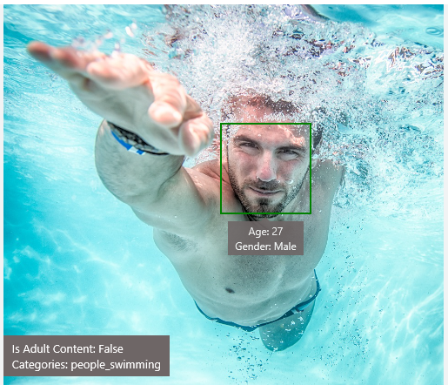
Analyze Image – Example
Type of Image:
Clip Art Type 0 Non-clipart
Line Drawing Type 0 Non-Line Drawing
Black & White Image False
Content of Image:
Categories [{ “name”: “people_swimming”, “score”: 0.099609375 }]
Adult Content False
Adult Score 0.18533889949321747
Faces [{ “age”: 27, “gender”: “Male”, “faceRectangle”: {“left”: 472, “top”: 258, “width”: 199, “height”: 199}}]
Image Colors:
Dominant Color Background White
Dominant Color Foreground Grey
Dominant Colors White
Accent Color

Slide 15
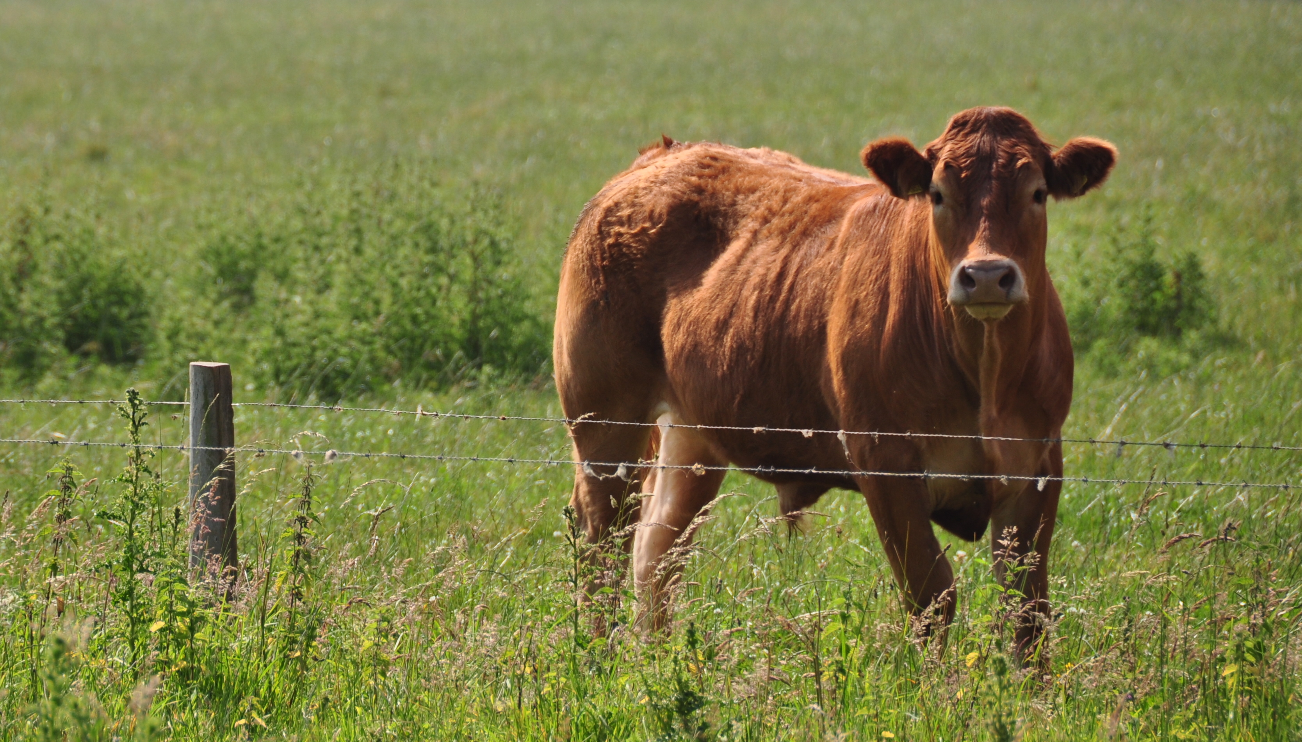
Analyze Image – Example
Content of Image:
Categories v0: [{ “name”: “animal”, “score”: 0.9765625 }]
V1: [{ "name": "grass", "confidence": 0.9999992847442627 },
{ "name": "outdoor", "confidence": 0.9999072551727295 },
{ "name": "cow", "confidence": 0.99954754114151 },
{ "name": "field", "confidence": 0.9976195693016052 },
{ "name": "brown", "confidence": 0.988935649394989 },
{ "name": "animal", "confidence": 0.97904372215271 },
{ "name": "standing", "confidence": 0.9632768630981445 },
{ "name": "mammal", "confidence": 0.9366017580032349, "hint": "animal" },
{ "name": "wire", "confidence": 0.8946959376335144 },
{ "name": "green", "confidence": 0.8844101428985596 },
{ "name": "pasture", "confidence": 0.8332059383392334 },
{ "name": "bovine", "confidence": 0.5618471503257751, "hint": "animal" },
{ "name": "grassy", "confidence": 0.48627158999443054 },
{ "name": "lush", "confidence": 0.1874018907546997 },
{ "name": "staring", "confidence": 0.165890634059906 }]
Describe
0.975 "a brown cow standing on top of a lush green field“
0.974 “a cow standing on top of a lush green field”
0.965 “a large brown cow standing on top of a lush green field”

Slide 16

Wackcoon

Slide 17
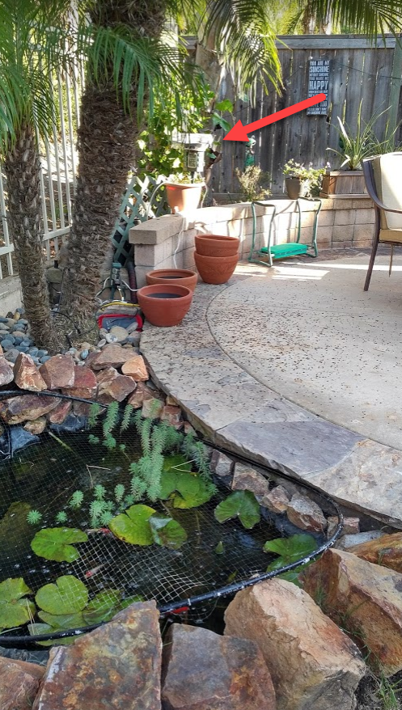
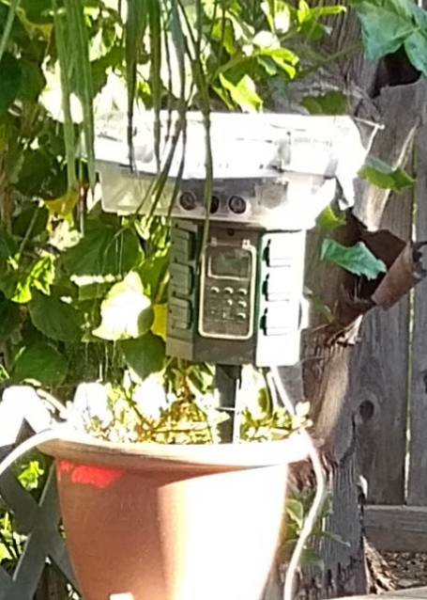
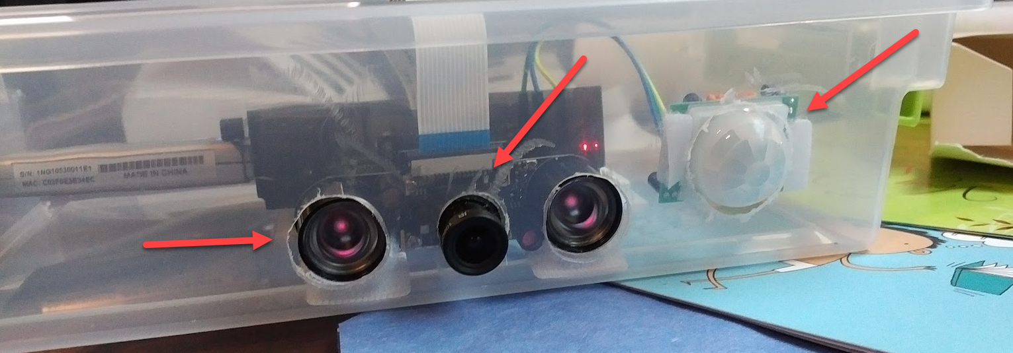
Wackcoon
Content of Image:
Categories v0: [{ “name”: “animal”, “score”: 0.9765625 }]
V1: [{ "name": "grass", "confidence": 0.9999992847442627 },
{ "name": "outdoor", "confidence": 0.9999072551727295 },
{ "name": "cat", "confidence": 0.99954754114151 },
{ "name": "raccoon", "confidence": 0.9976195693016052 },
{ "name": "grey", "confidence": 0.988935649394989 },
{ "name": "animal", "confidence": 0.97904372215271 },
{ "name": "standing", "confidence": 0.9632768630981445 },
{ "name": "mammal", "confidence": 0.9366017580032349, "hint": "animal" },
{ "name": "aquarium", "confidence": 0.8946959376335144 },
{ "name": "green", "confidence": 0.8844101428985596 },
{ "name": "grass", "confidence": 0.8332059383392334 },
{ "name": "water", "confidence": 0.5618471503257751 },
{ "name": "grassy", "confidence": 0.48627158999443054 },
{ "name": "lush", "confidence": 0.1874018907546997 },
{ "name": "staring", "confidence": 0.165890634059906 }]

Slide 18
OCR Service
Detect and recognize words within a photo

Slide 19

OCR – Example
TEXT:
LIFE IS LIKE
RIDING A BICYCLE
TO KEEP YOUR BALANCE
YOU MUST KEEP MOVING
JSON:
{
"language": "en",
"orientation": "Up",
"regions": [
{
"boundingBox": "41,77,918,440",
"lines": [
{
"boundingBox": "41,77,723,89",
"words": [
{
"boundingBox": "41,102,225,64",
"text": "LIFE"
},
{
"boundingBox": "356,89,94,62",
"text": "IS"
},
{
"boundingBox": "539,77,225,64",
"text": "LIKE"
}
. . .

Slide 20
Smart Thumbnail Service
Scale and crop an image, while retaining key content

Slide 21




Smart Thumbnail – Example

Slide 22
Face APIs Detection
Verification
Grouping
Identification

Slide 23
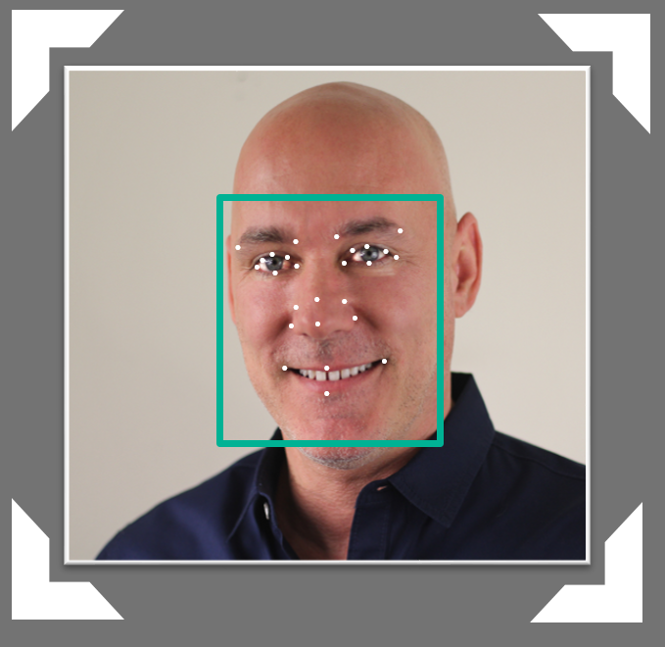

Face API – Detection
Detection Result:
JSON:
[
{
"faceRectangle": {
"width": 109,
"height": 109,
"left": 62,
"top": 62
},
"attributes": {
"age": 41,
"gender": "male",
"headPose": {
"roll": "2.9",
"yaw": "-1.3",
"pitch": "0.0"
}
"faceLandmarks": {
"pupilLeft": {
"x": "93.6",
"y": "88.2"
},
"pupilRight": {
"x": "138.4",
"y": "91.7"
},
...
DETECTION
ATTRIBUTES
INPUT IMAGE
FACIAL RECTANGLE + LANDMARKS

Slide 24
Face API – Detection
Detection Result:
JSON:
[
{
"faceRectangle": {
"width": 109,
"height": 109,
"left": 62,
"top": 62
},
"attributes": {
"age": 31,
"gender": "male",
"headPose": {
"roll": "2.9",
"yaw": "-1.3",
"pitch": "0.0"
}
"faceLandmarks": {
"pupilLeft": {
"x": "93.6",
"y": "88.2"
},
"pupilRight": {
"x": "138.4",
"y": "91.7"
},
...
.
.
.
.
.
.
.
.
.
.
.
.
.
.
.
.
.
.
.
.
.
.
.
.
.
.

Slide 25

Face API – Verification
Given two faces, determine whether they are the same person
Verification Result:
JSON:
[
{
"isIdentical":false,
"confidence":0.01
}
]
.
.
.
.
.
.
.
.
.
.
.
.
.
.

Slide 26
Demo
microsoft.com/cognitive
Start coding
Lets see the online API

Slide 27


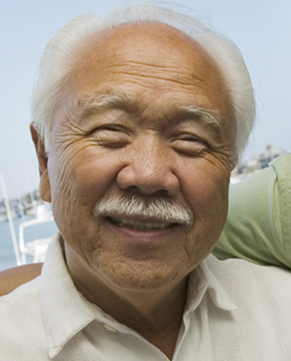

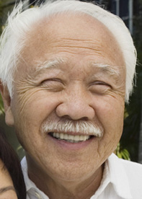

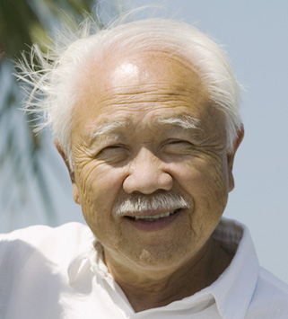





Face API – Grouping
CLUSTERED BY
DETECTED PEOPLE

Slide 28




Face API – Create Person Object
DETECTION
INPUT IMAGE
FACIAL RECTANGLE + LANDMARKS
Daniel
Egan
Daniel Egan
COLLEAGUES
COLLEAGUES
COLLEAGUES
CREATE PERSON GROUP
ADD PERSON

Slide 29



Face API – Identify
Natalie Huber
He is Daniel Egan.
IDENTIFY
GROUP PERSON OBJECTS
NEW INPUT IMAGE
RECOGNITION
Daniel Egan
COLLEAGUES

Slide 30
Speech APIs powered by Bing
Voice Recognition (Speech to Text)
Voice Output (Text to Speech)

Slide 31

Voice Recognition
es-ES
de-DE
fr-FR
en-GB
it-IT
en-US
zh-CN
Converts spoken audio to text
Same backend which powers Cortana
Support for 7 languages at launch

Slide 32
Voice Recognition
REST API
Client Library
SUPPORTED PLATFORMS
Any
Windows, Android, iOS
DATA SUPPORT
Yes
Yes
MIC SUPPORT
No
Yes
SILENCE DETECTION ON MIC
No
Yes
LENGTH OF UTTERANCE
Short
Short and long
NUMBER OF RESPONSES
n-best response back
multiple partial results, n-best (short) and multiple phrases (long)
Windows 10 has Speech APIs built in

Slide 33
Voice Recognition Modes
Short Form
Long Form
Duration of Audio | < 15 seconds | < 2 minutes
Final Result | n-best choice | Best Choice, delivered at sentence pauses
Partial Results | No | Yes
450 6th St. San Francisco
********* Final N-BEST Results *********
[0] Confidence=Normal Text="450 six St San Francisco."
[1] Confidence=Normal Text="For 50 six St San Francisco."
[2] Confidence=Normal Text="456th St San Francisco."
[3] Confidence=Normal Text="450 six St in San Francisco."
[4] Confidence=Normal Text="456 St San Francisco."

Slide 34
The Adventures of LUIS and CRIS
Hi, I'm CRIS
Hi, I'm LUIS

Slide 35
LUIS Language Understanding Intelligent Service Determine Intent
Detect Entities
Improve Models

Slide 36
Language Understanding Intelligent Service
Lets you understand what your users are saying
Seamless integration with Speech Recognition
A few examples are enough to deploy an application
LUIS learns over time
Define
Concepts
Provide
Examples
Deploy
Active Learning

Slide 37
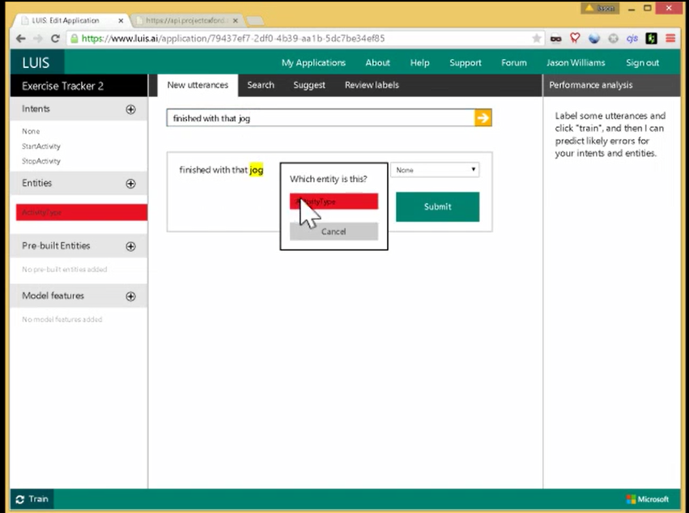

Slide 38
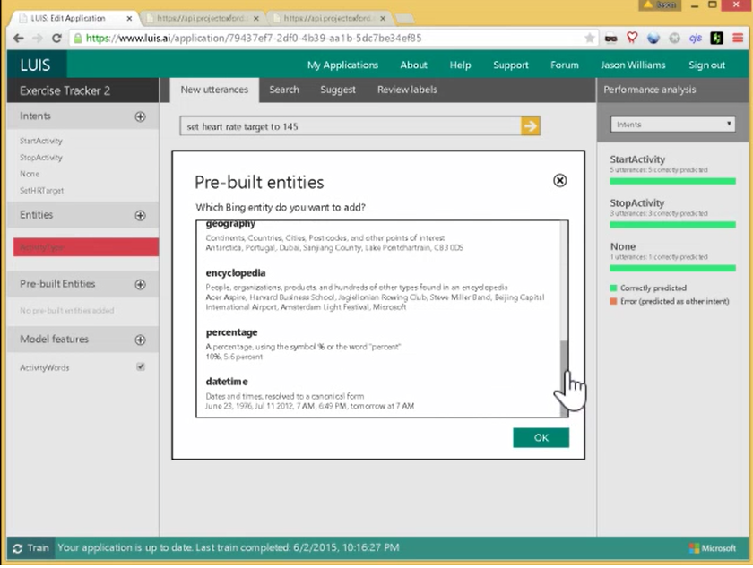

Slide 39
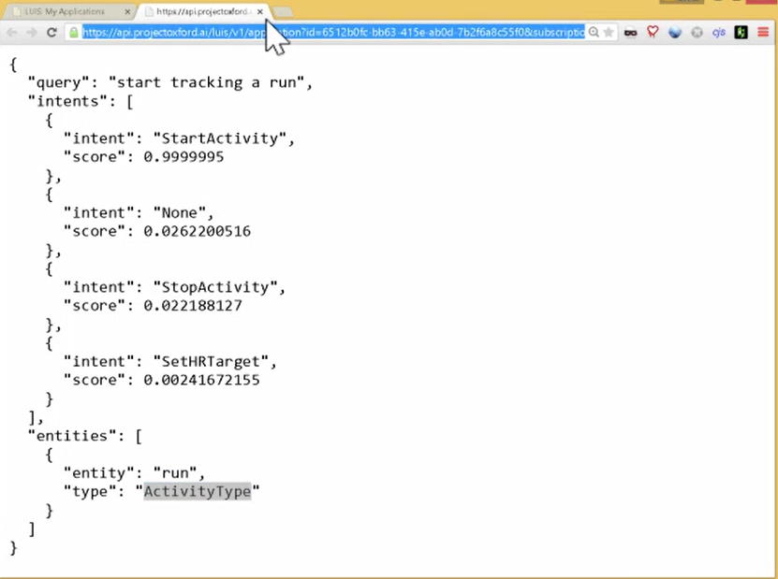

Slide 40
Language Understanding Models
{
“entities”: [
{
“entity”: “flight_delays”,
“type”: “Topic”
}
],
“intents”: [
{
“intent”: “FindNews”,
“score”: 0.99853384
},
{
“intent”: “None”,
“score”: 0.07289317
},
{
“intent”: “ReadNews”,
“score”: 0.0167122427
},
{
“intent”: “ShareNews”,
“score”: 1.0919299E-06
}
]
}
“News about flight delays”

Slide 41

Custom Recognition Intelligent Service
Lets you overcome speech recognition barriers like speaking style, background noise, and vocabulary.
Custom language models
Custom acoustic models
Access Endpoint
Any Device

Slide 42
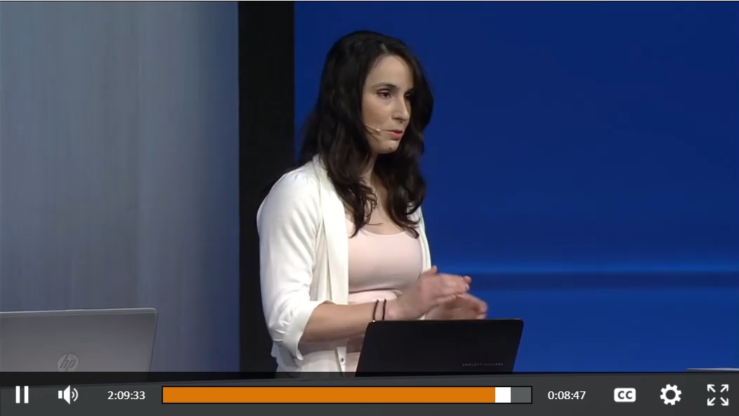

Slide 43
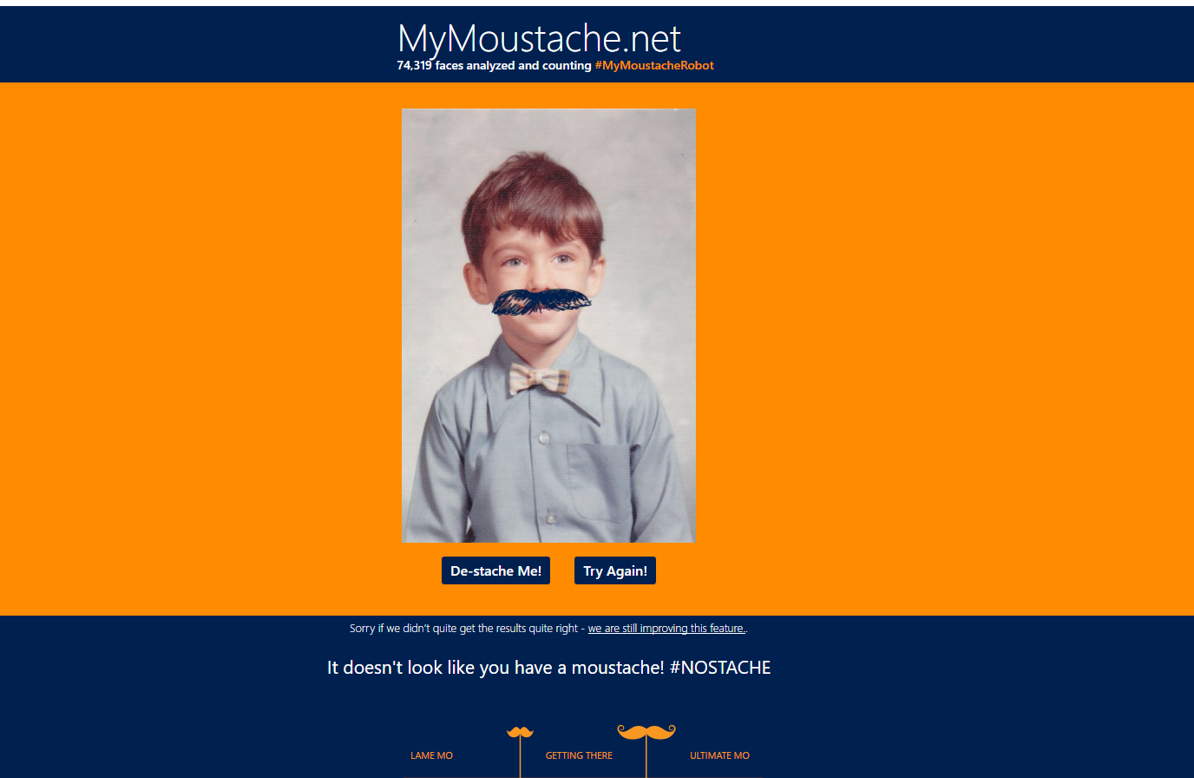

Slide 44
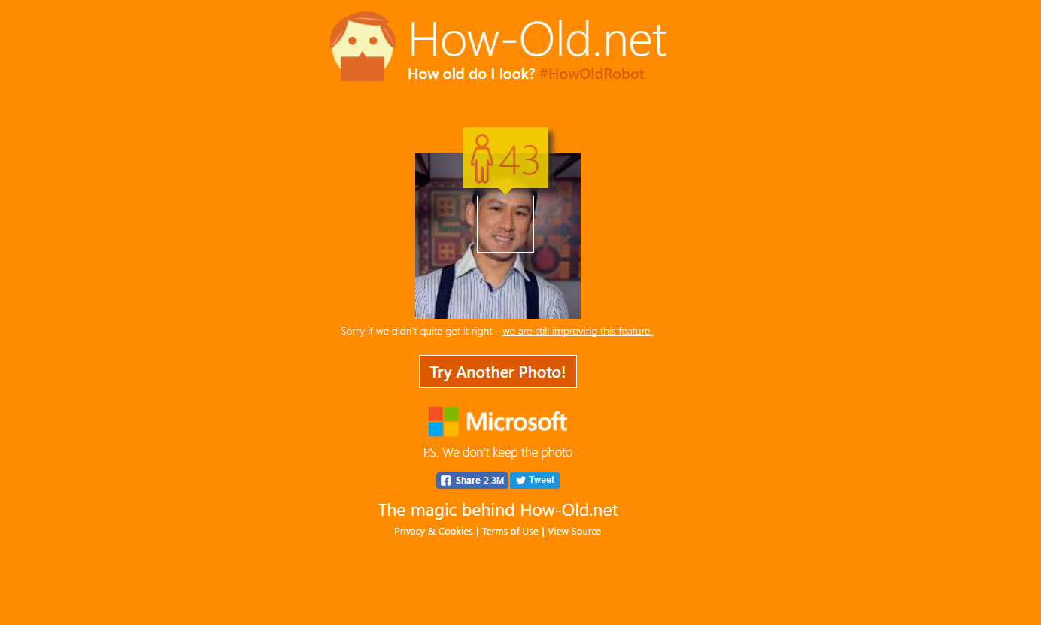

Slide 45
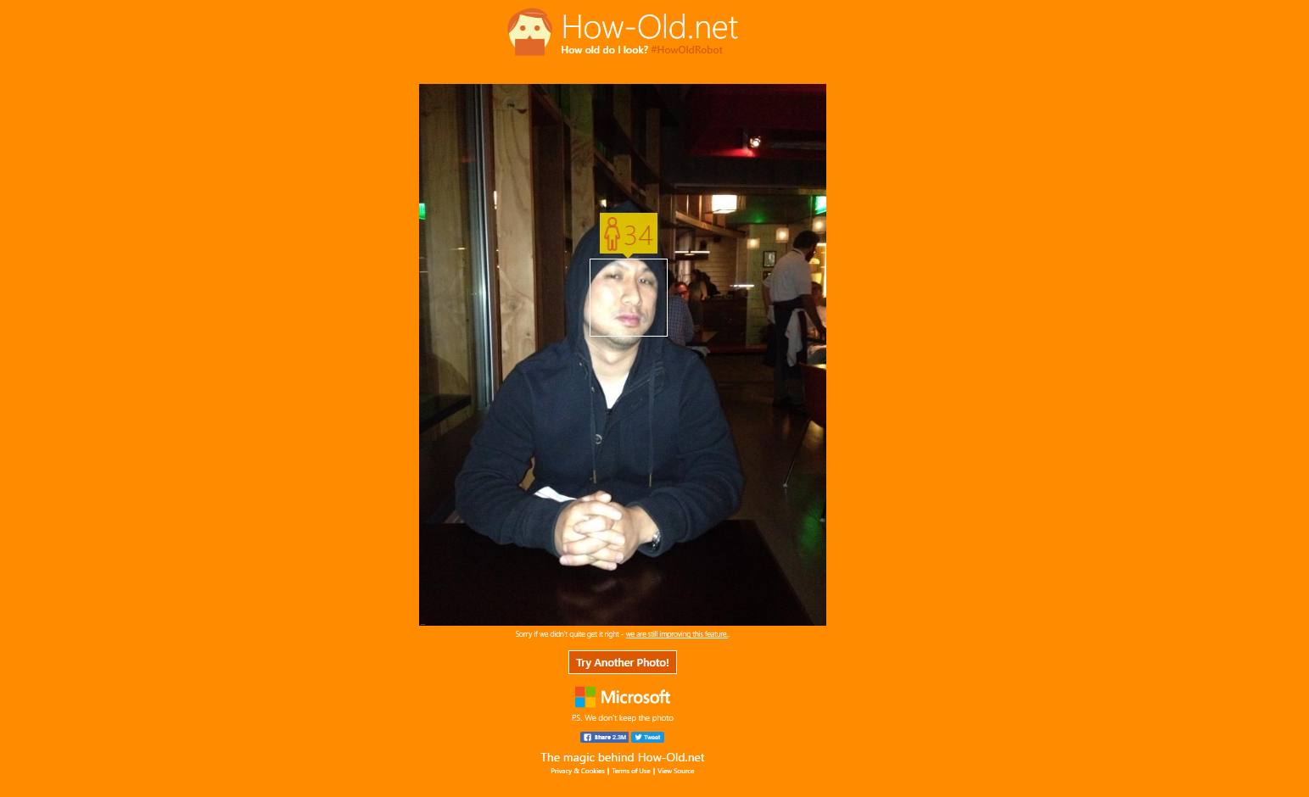

Slide 46


Slide 47
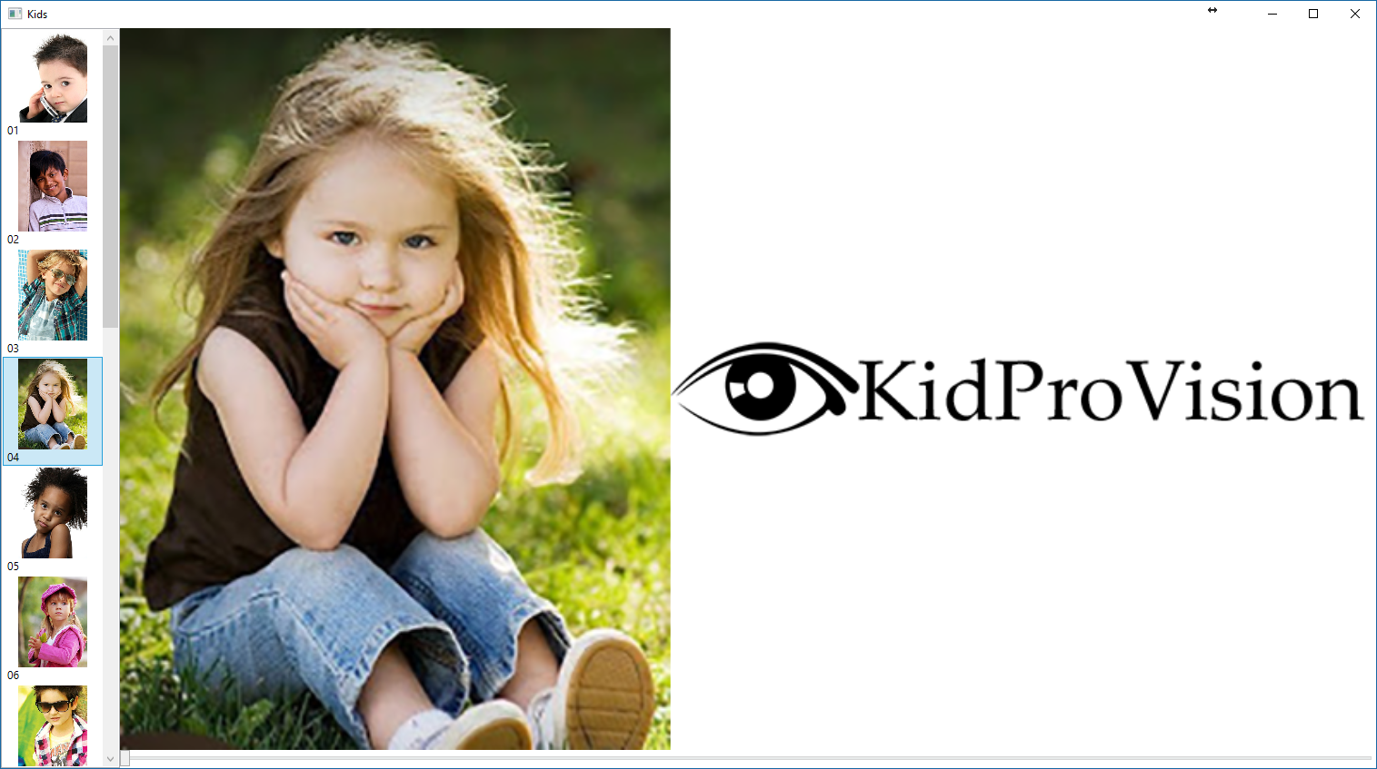

Slide 48
Demo
microsoft.com/cognitive
Start coding
Lets see the online API

Slide 49
Microsoft Cognitive Services
A portfolio of REST APIs and SDKs which enable developers to write applications which understand the content within the rapidly growing set of multimedia data

